Slide 1



eSports Devices
and Battles

Slide 2

Project Profile:
Project Title : | eSports Devices & Battles
Objective :- | The main objective of our Project is to Grow the eSports Culture in India
Application Type :- | Web Application
Front end :- | Python 3.7.3 With dJango Framework
Back end :- | MySQL
Guided By :- | Prof. Vidhi Bhatt
Group Number :- | 13
Group Member :- | 3
Develop By :- | Roll Number | Name | Contact Number
 | 22 | Sireen Gothadiya | +91 9773055968
 | 45 | Umang Modi | +91 6353558774
 | 06 | Parth Bavishi | +91 9714123036

Slide 3
Company Profile:
Company Name: | Logical Street Technology
External Guide :- | Mr. Rajnik Radadiya
Contact Number :- | +91 7600284160
Company Address :- | 407, Galaxy Business Park, Opp. Torrent Sub Station, Nr. Kathwada GIDC, Sardar Patel Ring Road, Nikol, Ahmedabad, Gujrat 382350.

Slide 4
ADMIN
Layout

Slide 5
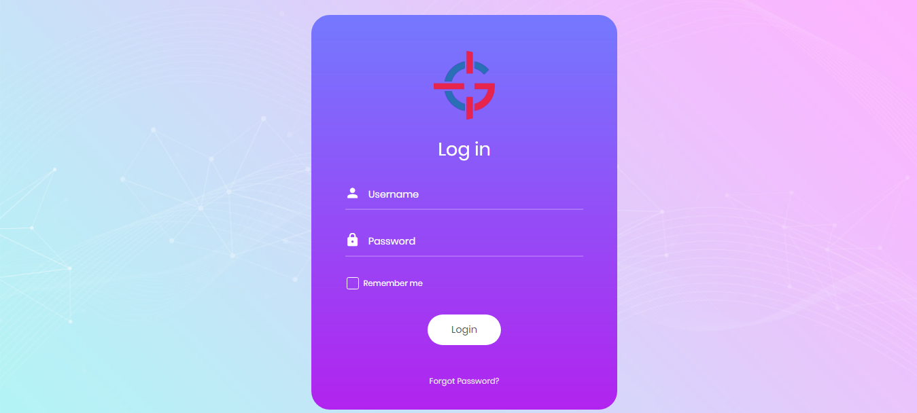
Login Process:
http://127.0.0.1:8000/login/

Slide 6
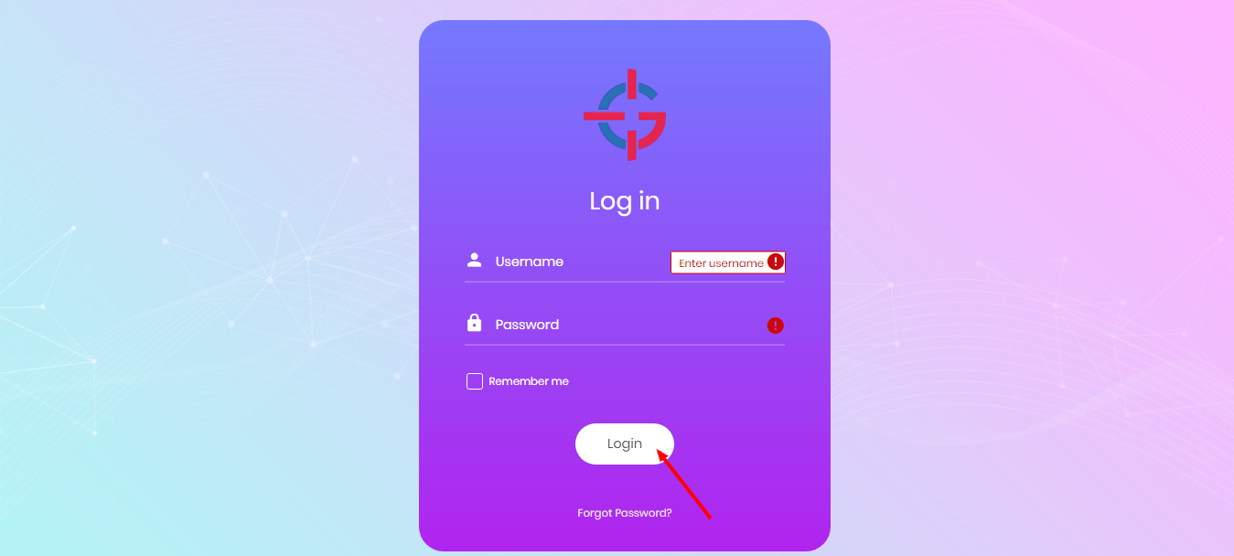
Login Process:
http://127.0.0.1:8000/login/

Slide 7
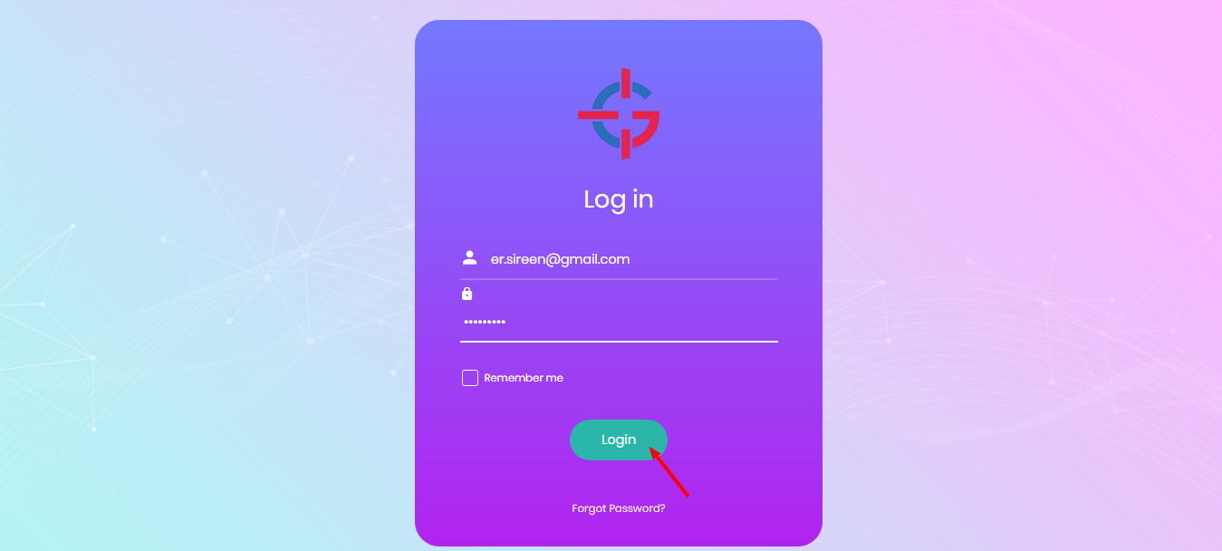
Login Process:
http://127.0.0.1:8000/login/

Slide 8

Forgot Password Process:
http://127.0.0.1:8000/login/

Slide 9
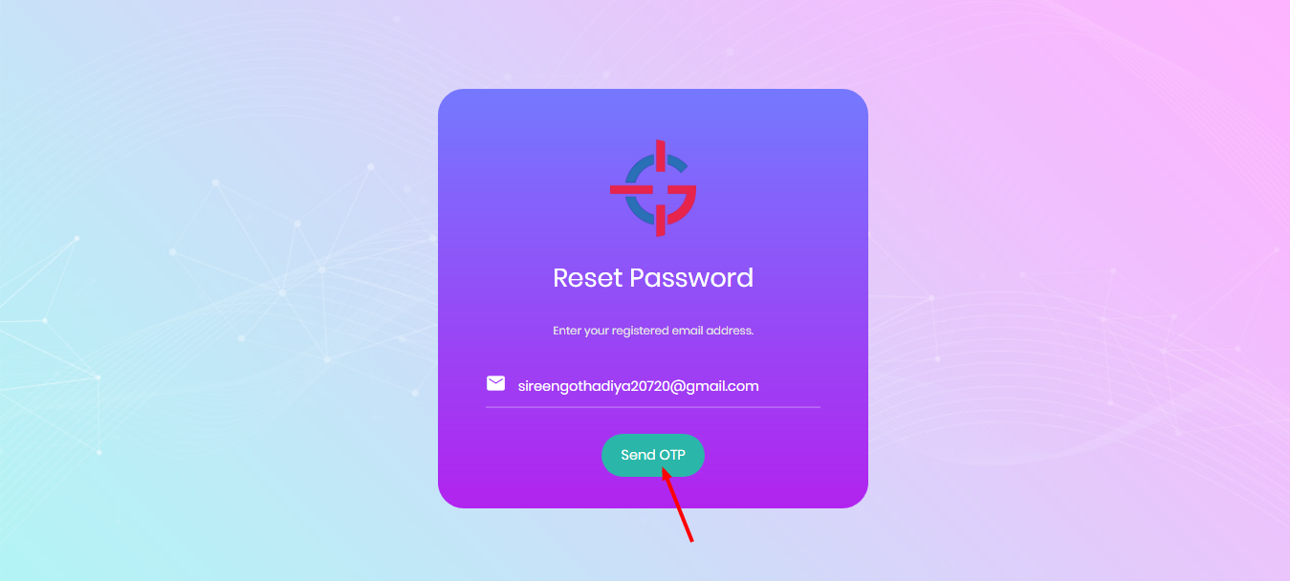
Forgot Password Process:
http://127.0.0.1:8000/forgot/

Slide 10
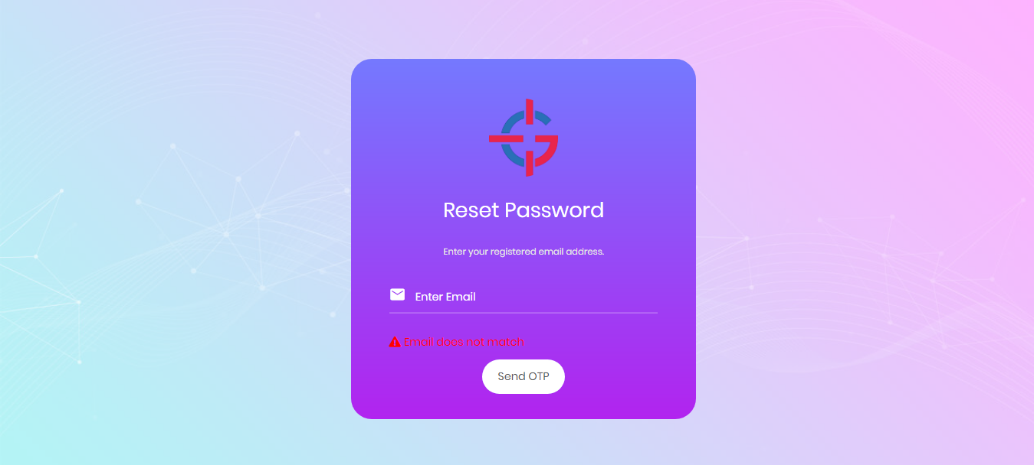
Forgot Password Process:
http://127.0.0.1:8000/forgot/

Slide 11
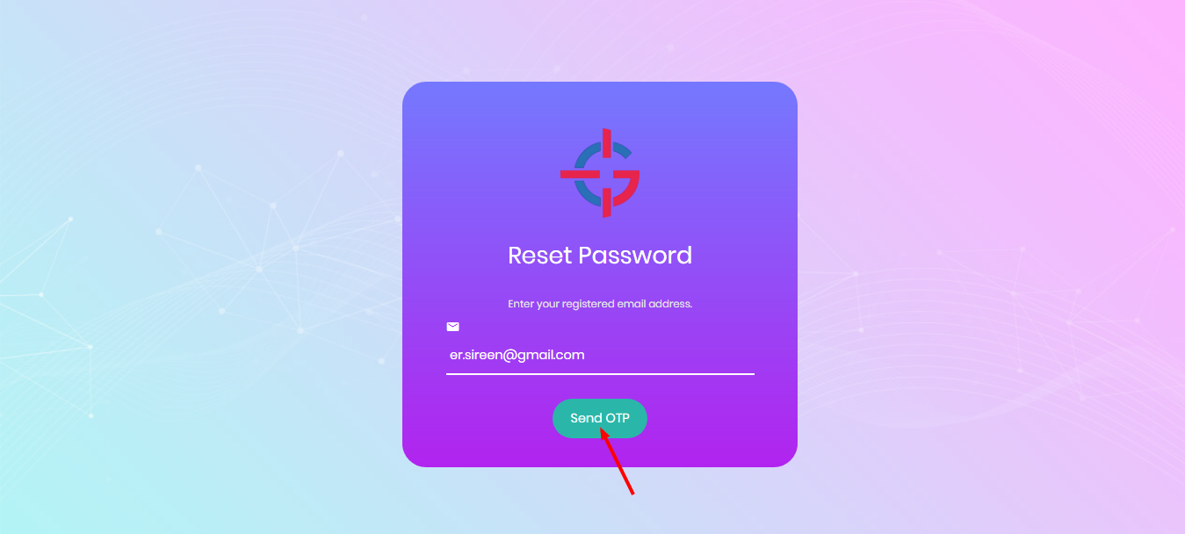
Forgot Password Process:
http://127.0.0.1:8000/forgot/

Slide 12
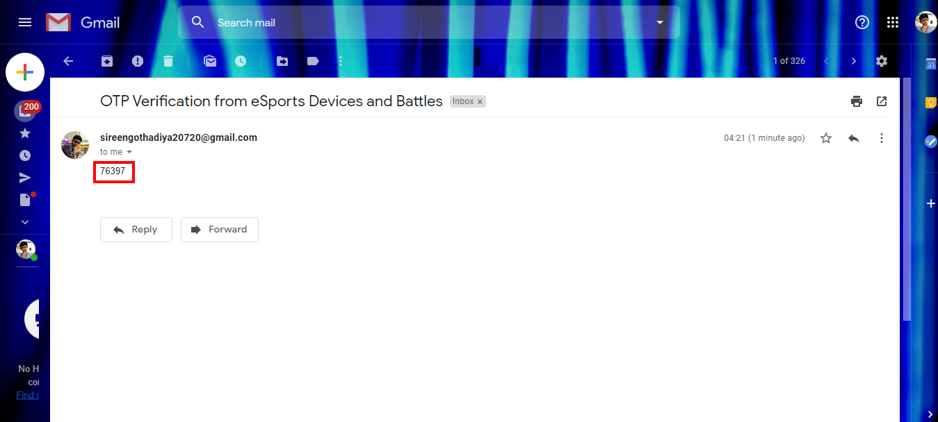
Forgot Password Process:
Admin Registered Gmail Account

Slide 13
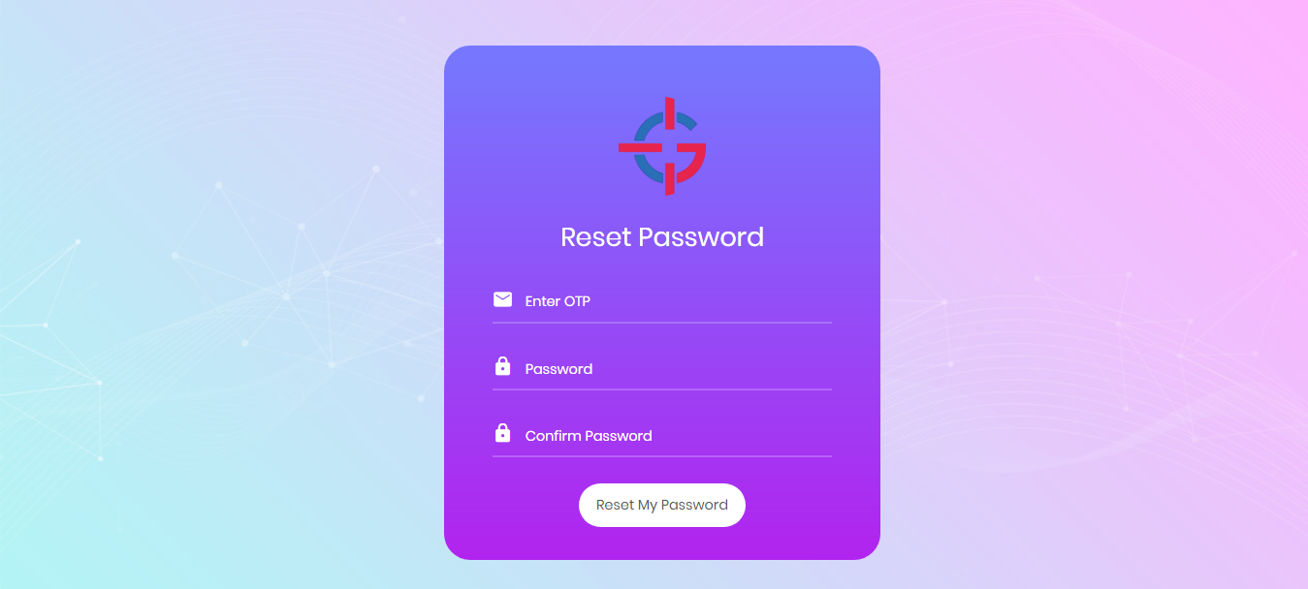
Forgot Password Process:
http://127.0.0.1:8000/send_otp/

Slide 14
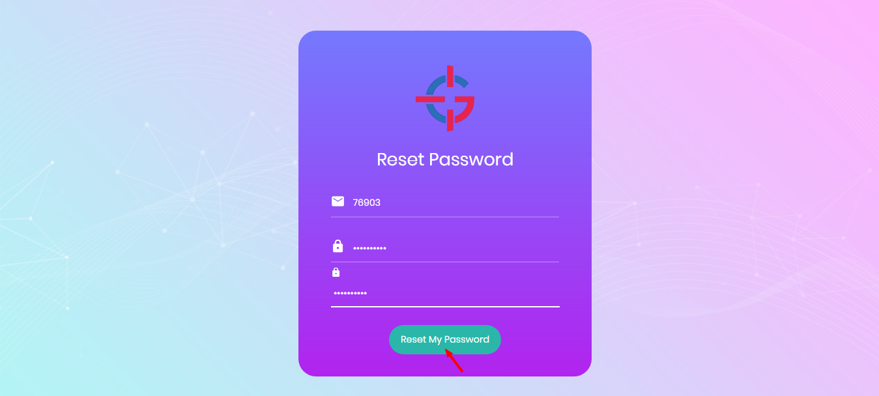
Forgot Password Process:
http://127.0.0.1:8000/send_otp/

Slide 15
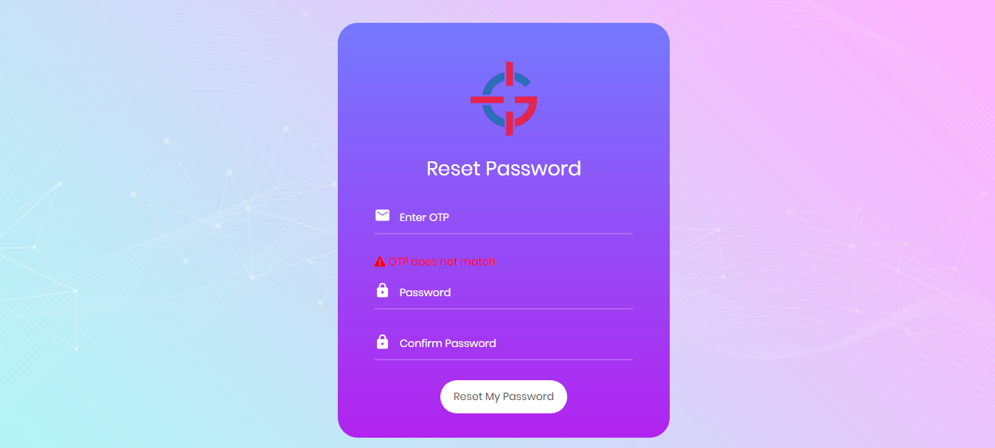
Forgot Password Process:
http://127.0.0.1:8000/send_otp/

Slide 16
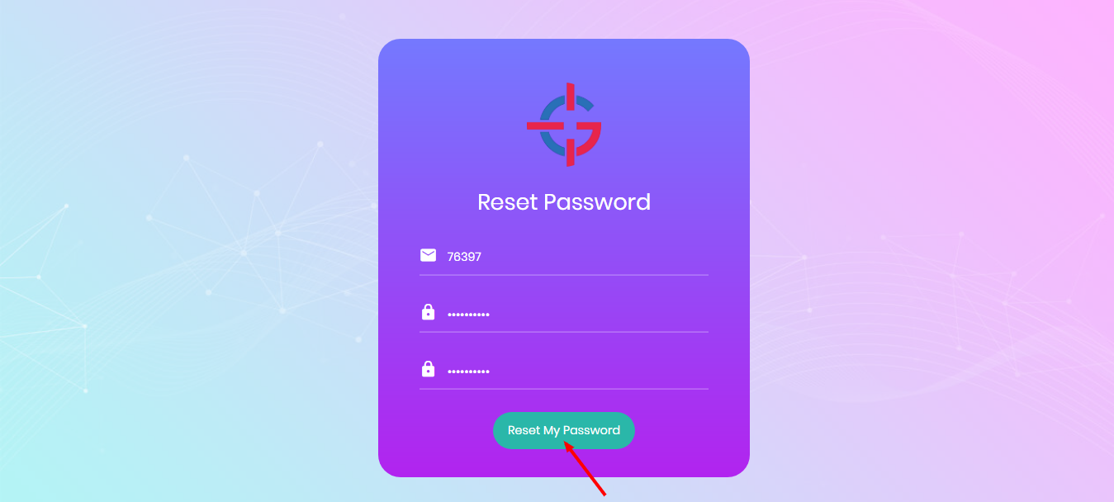
Forgot Password Process:
http://127.0.0.1:8000/send_otp/

Slide 17
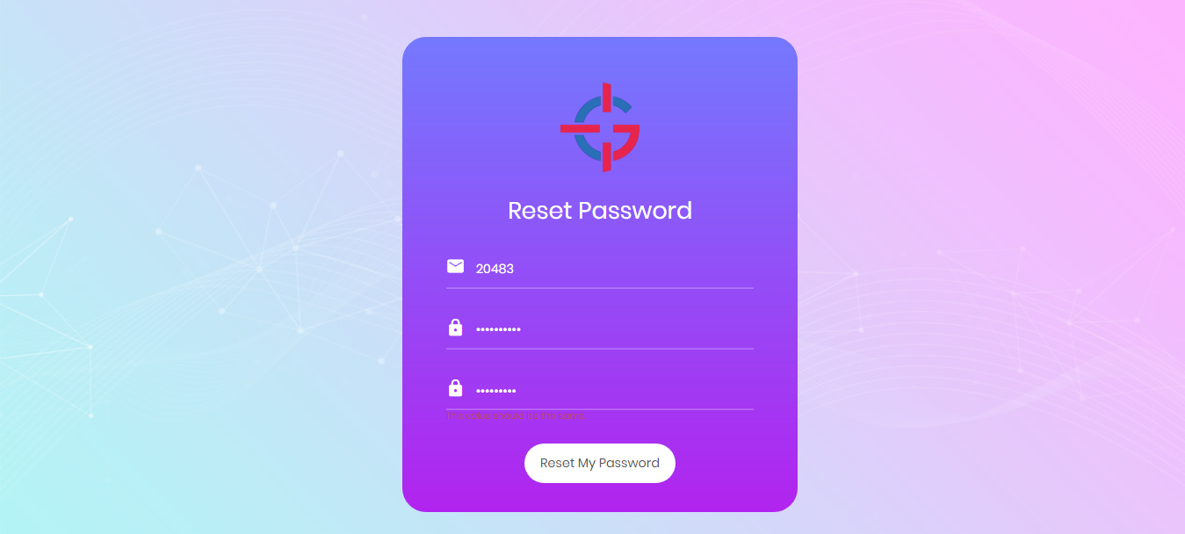
Forgot Password Process:
http://127.0.0.1:8000/send_otp/

Slide 18
Forgot Password Process:
http://127.0.0.1:8000/send_otp/

Slide 19
Login Process:
http://127.0.0.1:8000/login/

Slide 20
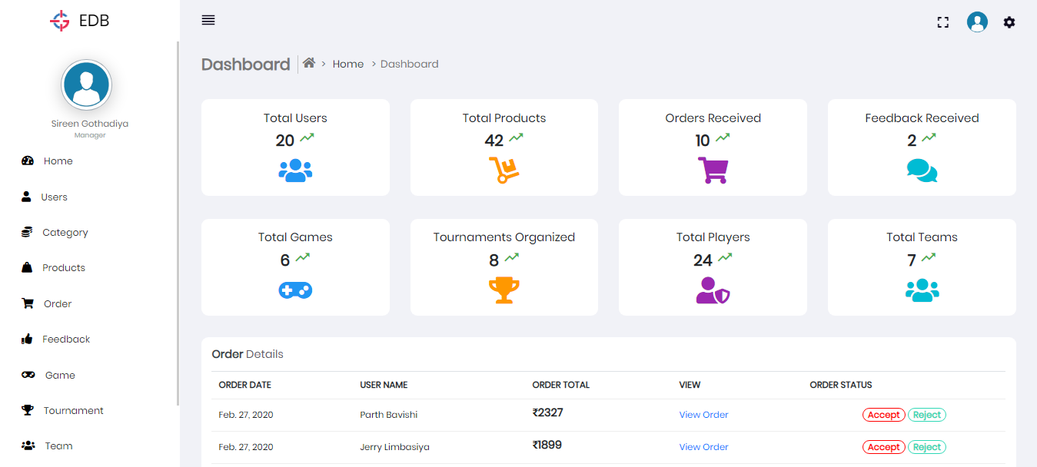
Dashboard:
http://127.0.0.1:8000/index/

Slide 21
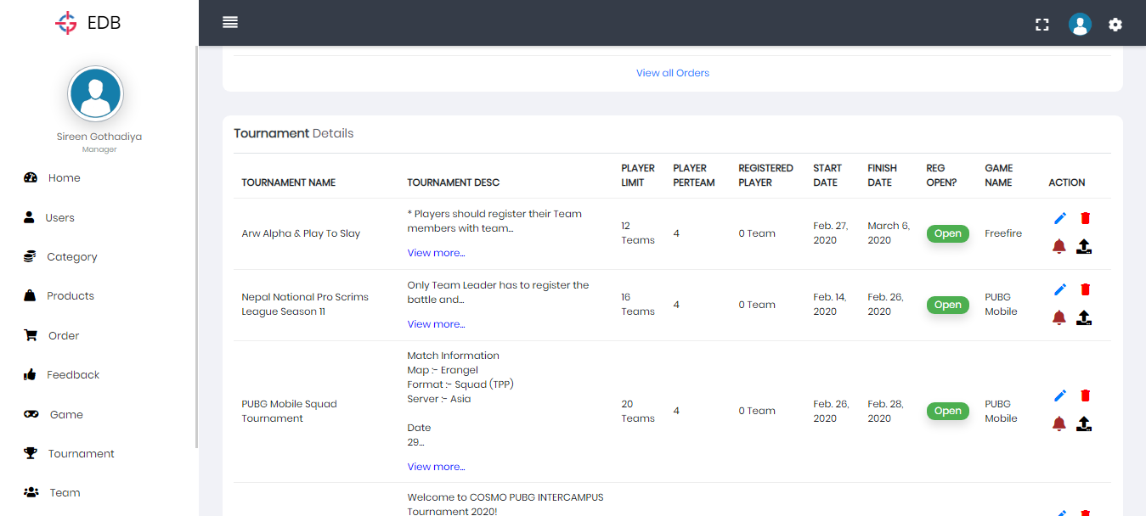
Dashboard:
http://127.0.0.1:8000/index/

Slide 22
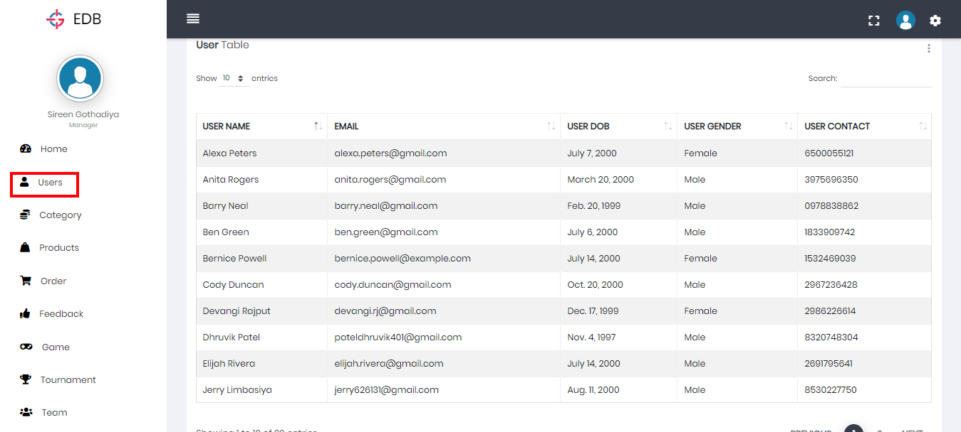
User Table:
http://127.0.0.1:8000/select-user/

Slide 23
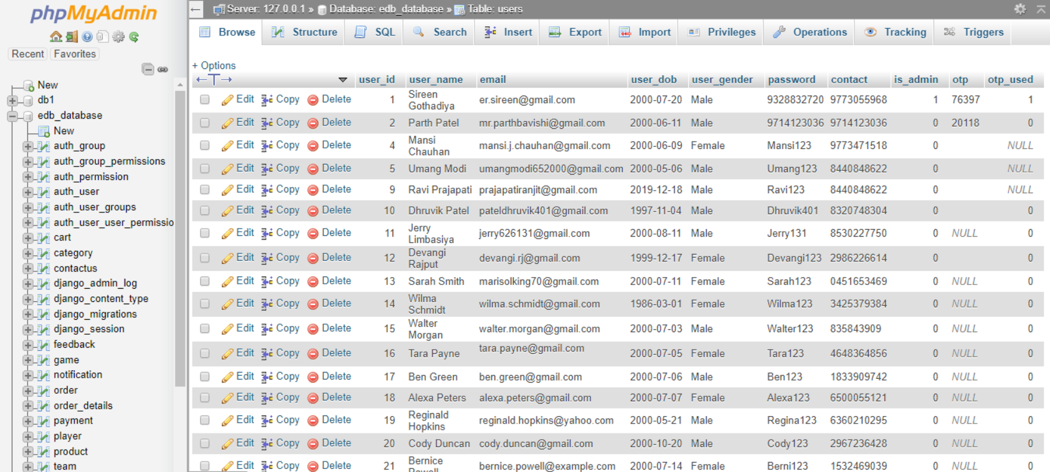
User Table:
http://localhost:10080/phpmyadmin/sql.php?db=edb_database&goto=db_structure.php&table=users&pos=0

Slide 24
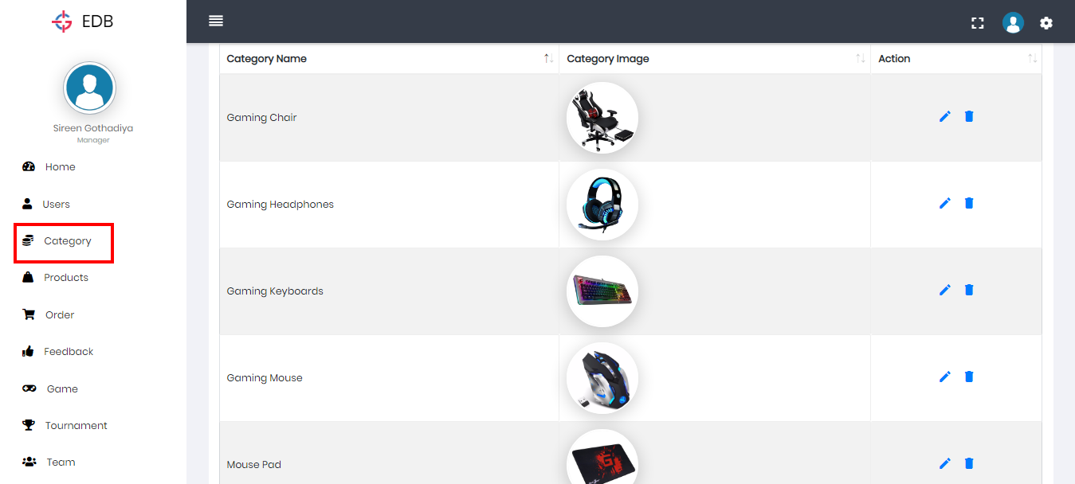
Category Table:
http://127.0.0.1:8000/select-category/

Slide 25
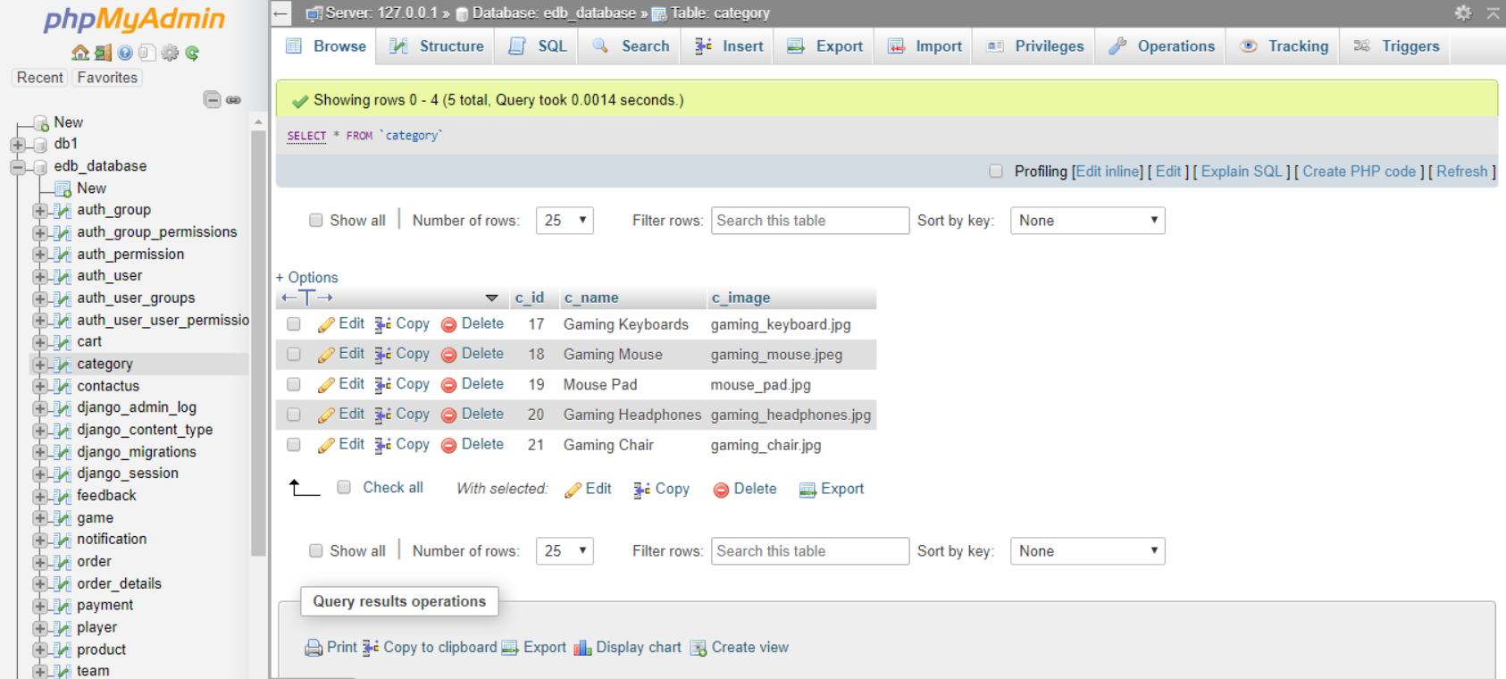
Category Table:
http://localhost:10080/phpmyadmin/sql.php?server=1&db=edb_database&table=category&pos=0

Slide 26
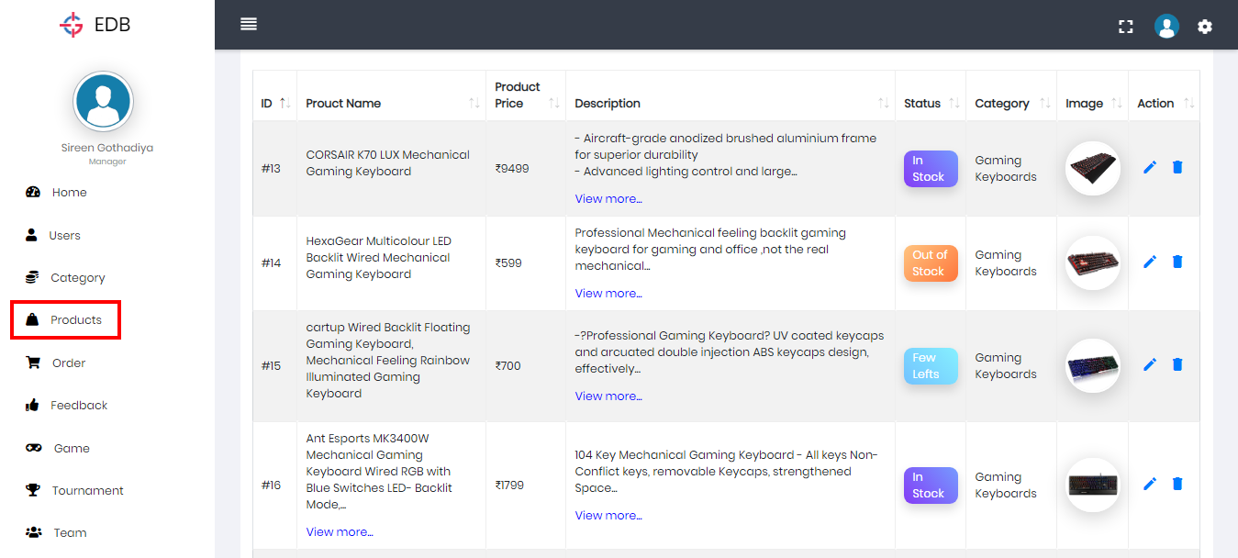
Product Table:
http://127.0.0.1:8000/select-product/

Slide 27
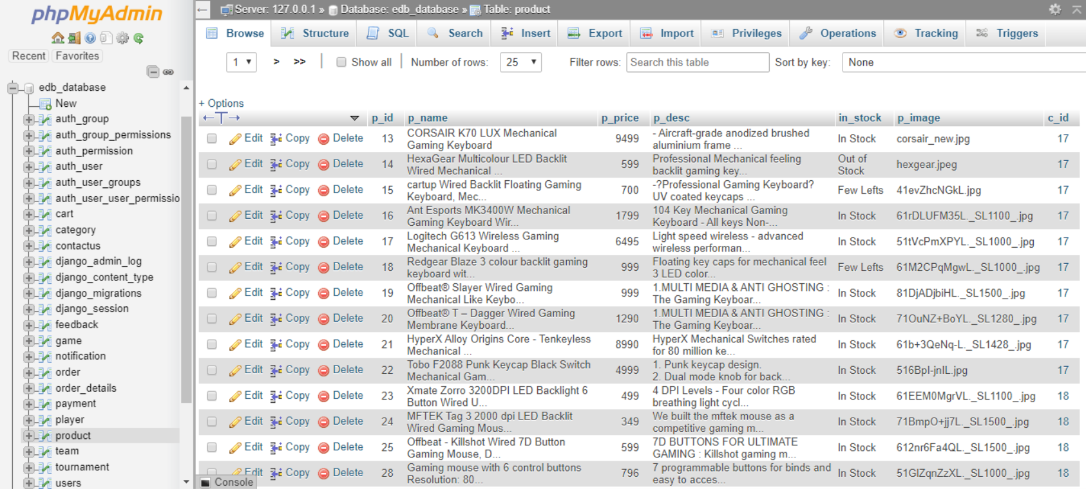
Product Table:
http://localhost:10080/phpmyadmin/sql.php?server=1&db=edb_database&table=product&pos=0

Slide 28
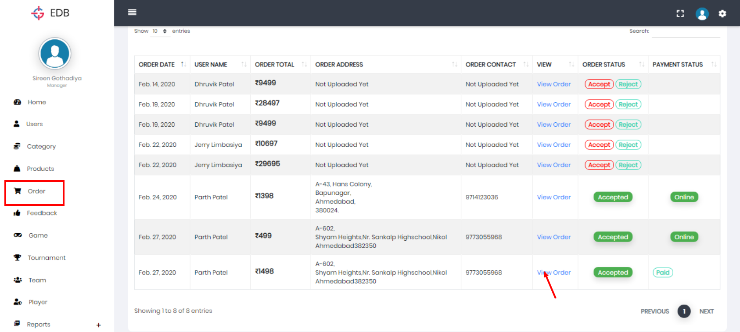
Order Table:
http://127.0.0.1:8000/select-order/

Slide 29
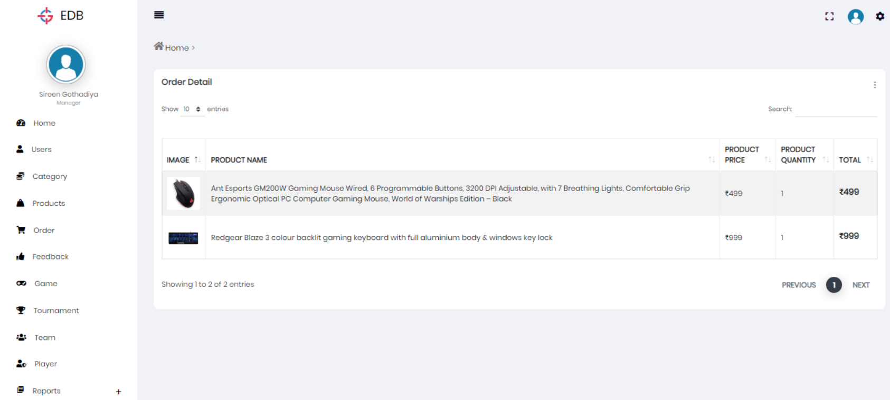
Order Table:
http://127.0.0.1:8000/order-detail/24

Slide 30
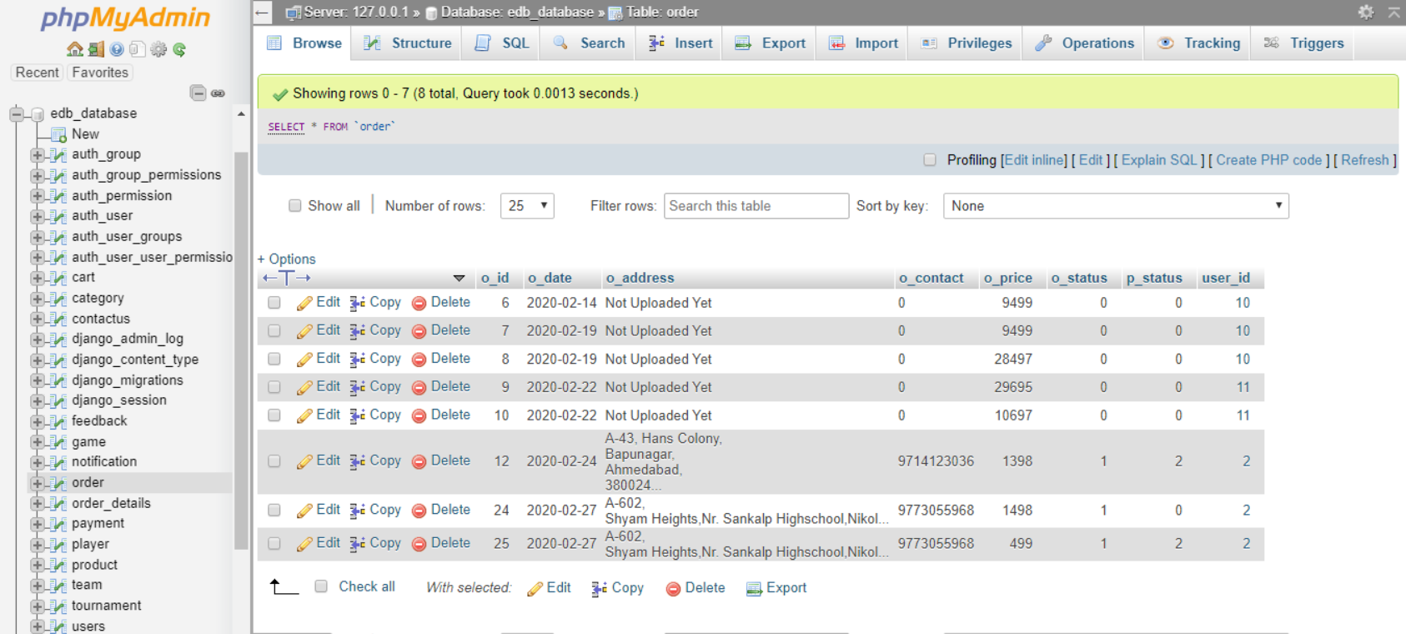
Order Table:
http://localhost:10080/phpmyadmin/sql.php?server=1&db=edb_database&table=order&pos=0

Slide 31
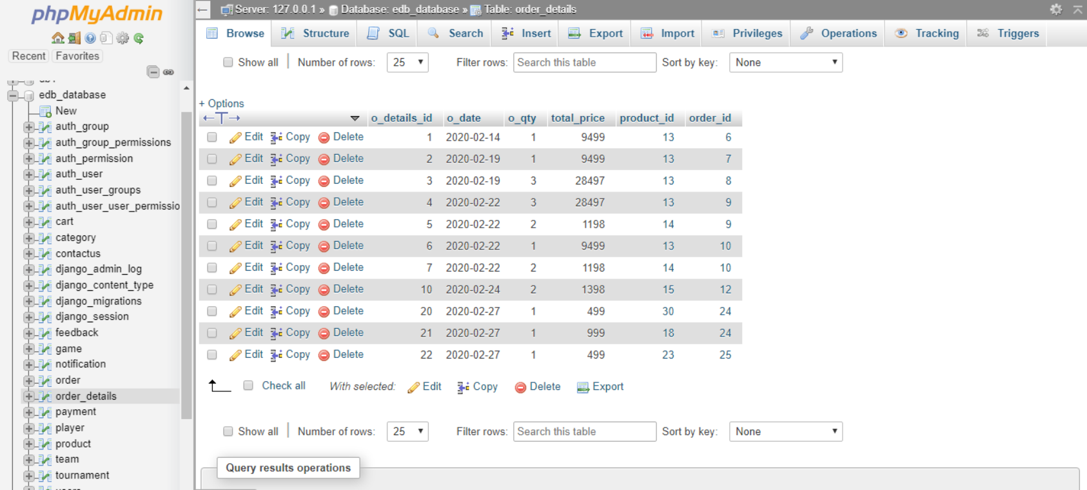
Order Details:
http://localhost:10080/phpmyadmin/sql.php?server=1&db=edb_database&table=order_details&pos=0

Slide 32
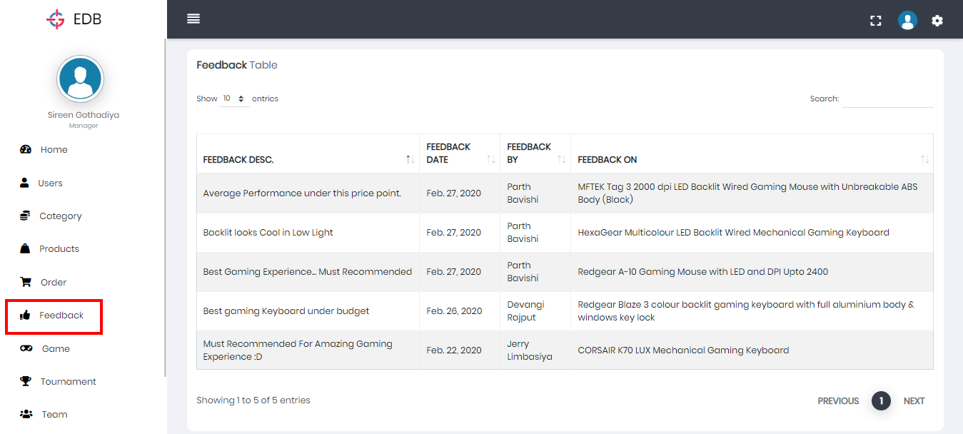
Feedback Table:
http://127.0.0.1:8000/select-feedback/

Slide 33
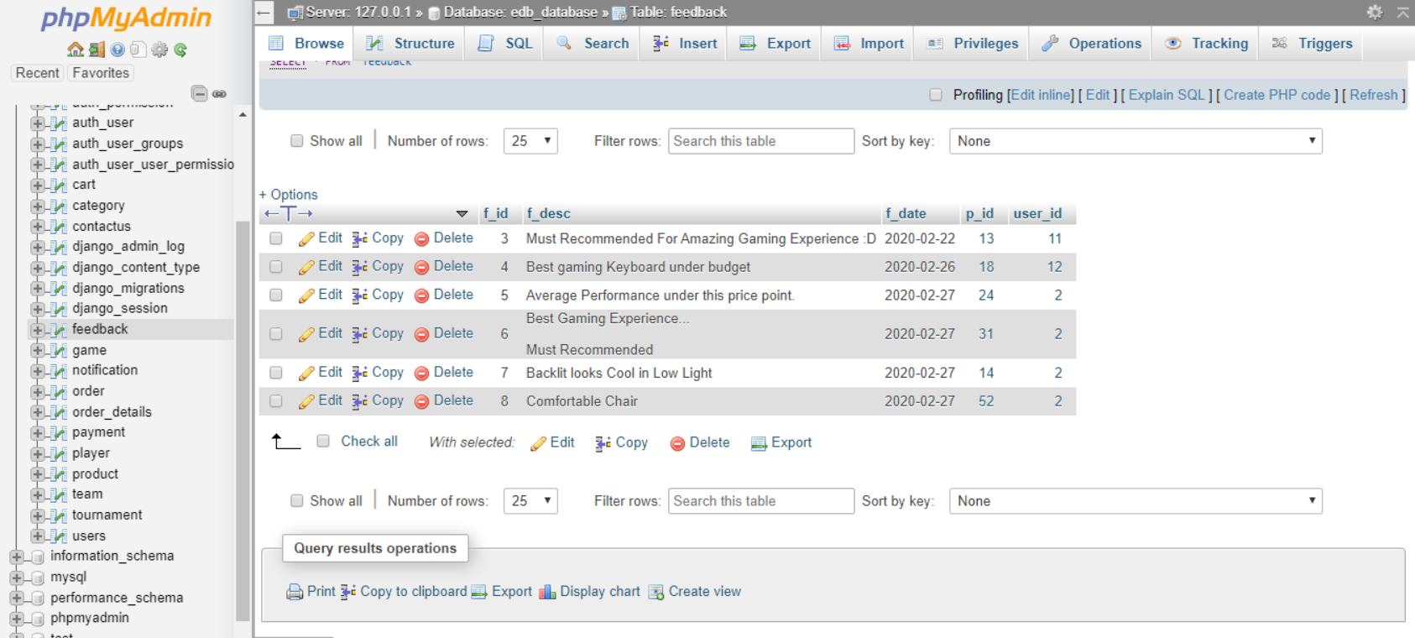
Feedback Table:
http://localhost:10080/phpmyadmin/sql.php?server=1&db=edb_database&table=feedback&pos=0

Slide 34
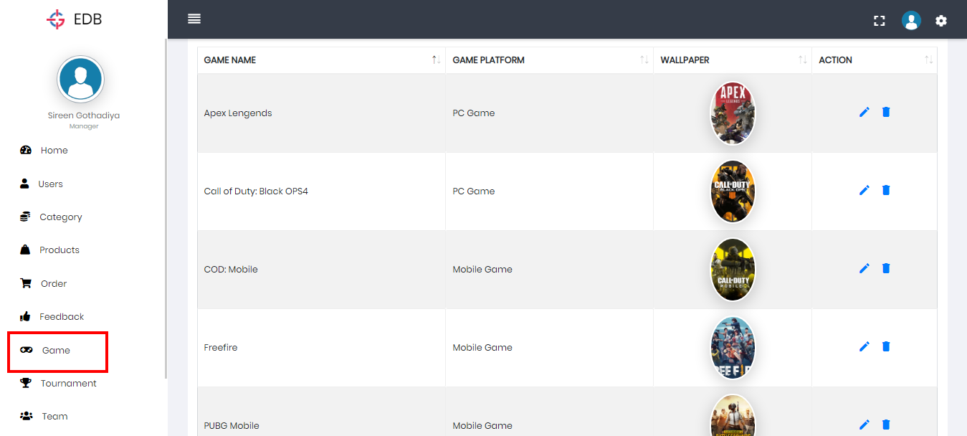
Game Table:
http://127.0.0.1:8000/select-game/

Slide 35
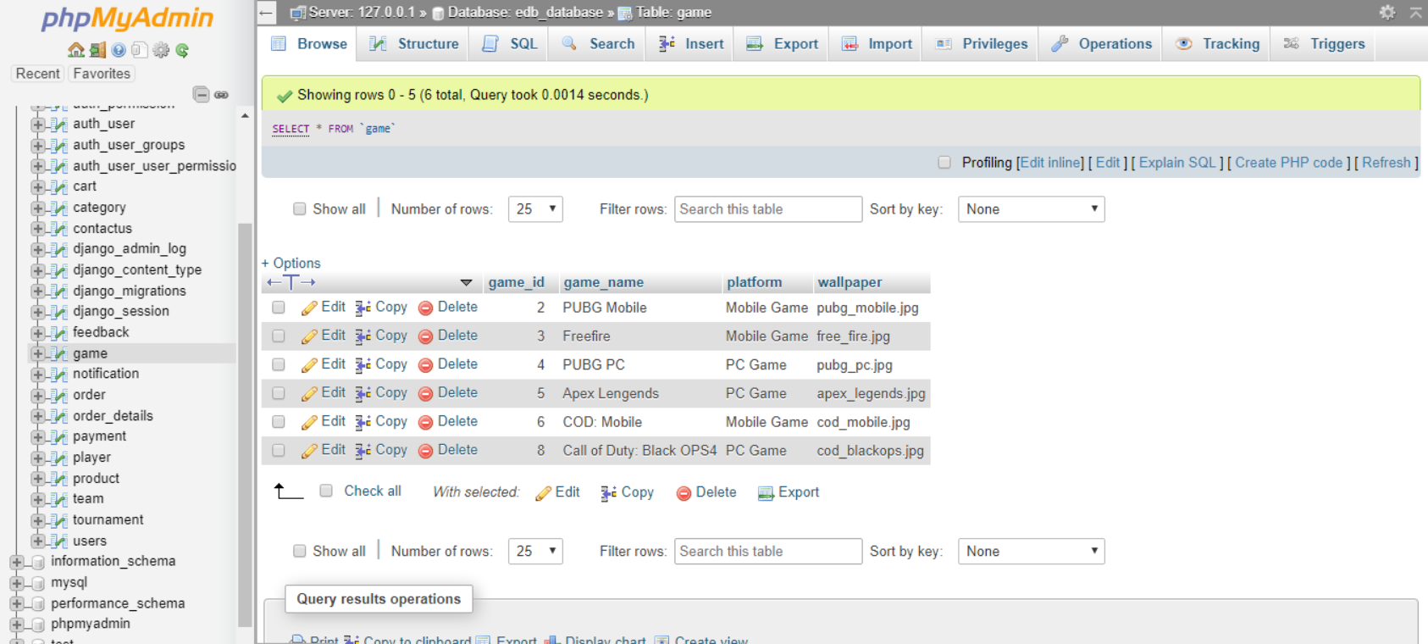
Game Table:
http://localhost:10080/phpmyadmin/sql.php?server=1&db=edb_database&table=game&pos=0

Slide 36
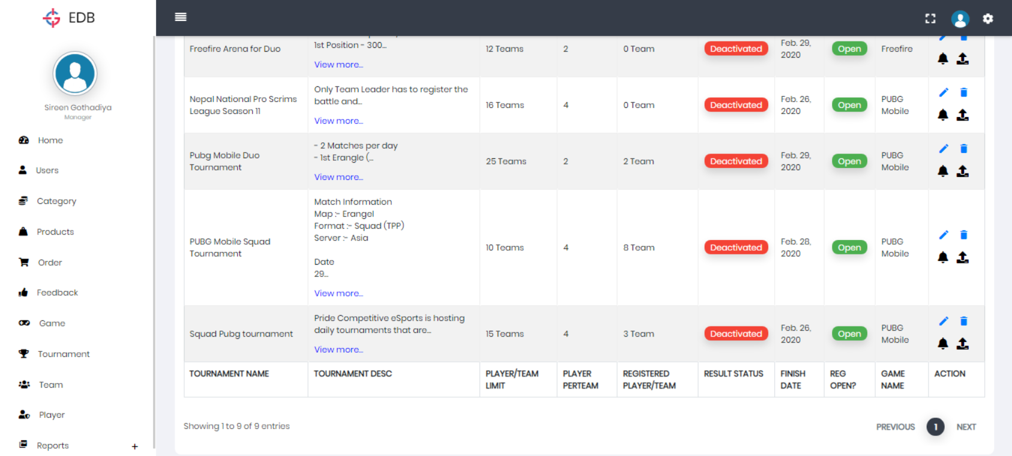
Tournament Table:
http://127.0.0.1:8000/select-tournament/

Slide 37
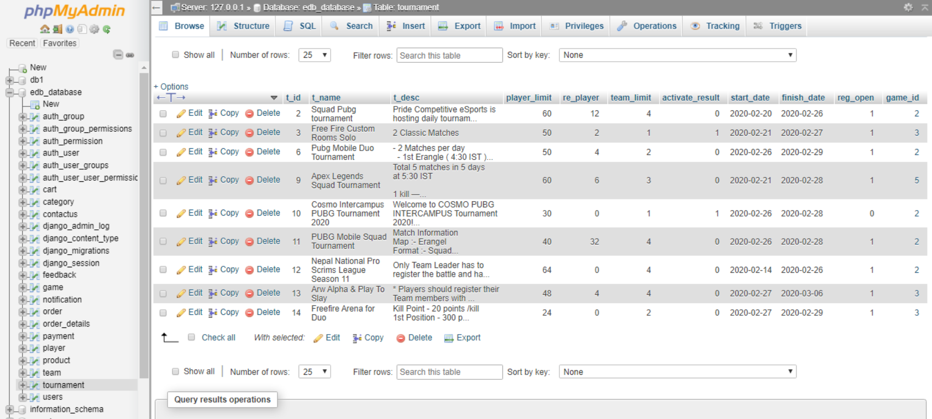
Tournament Table:
http://localhost:10080/phpmyadmin/sql.php?server=1&db=edb_database&table=tournament&pos=0

Slide 38
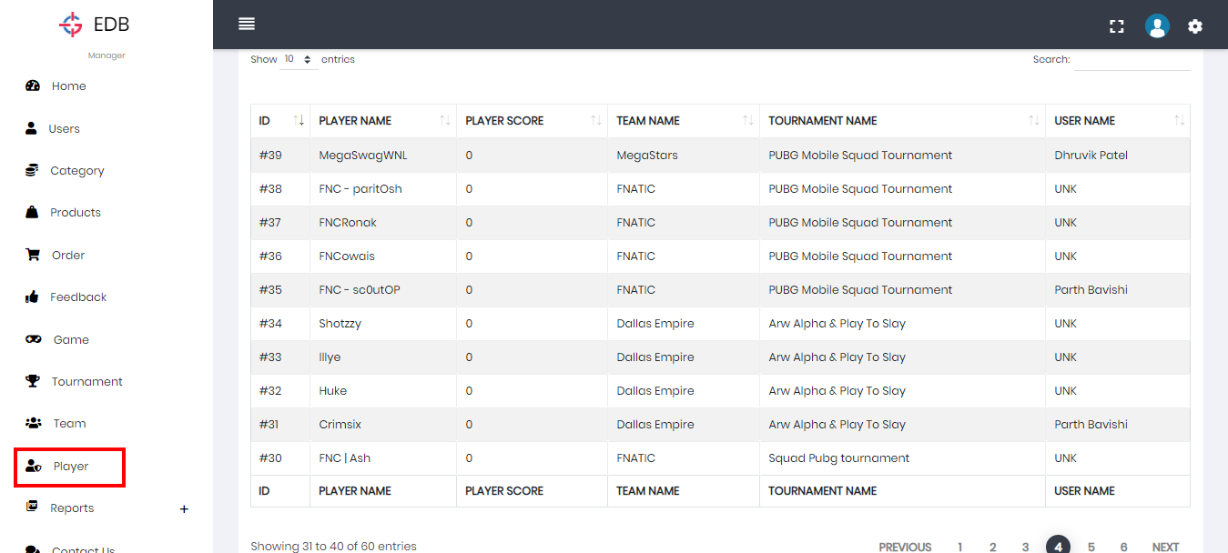
Player Table:
http://127.0.0.1:8000/select-player/

Slide 39
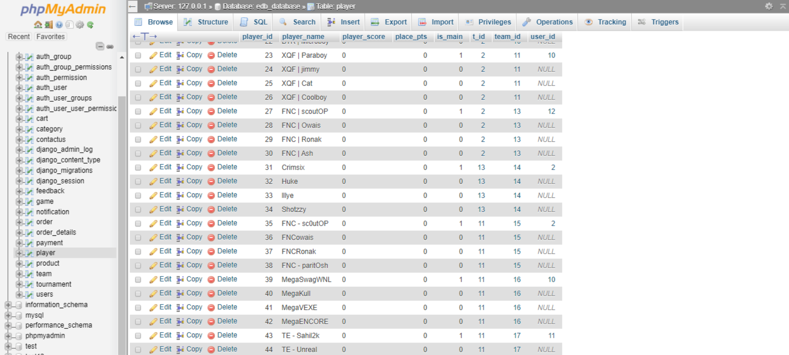
Player Table:
http://localhost:10080/phpmyadmin/sql.php?server=1&db=edb_database&table=player&pos=0

Slide 40
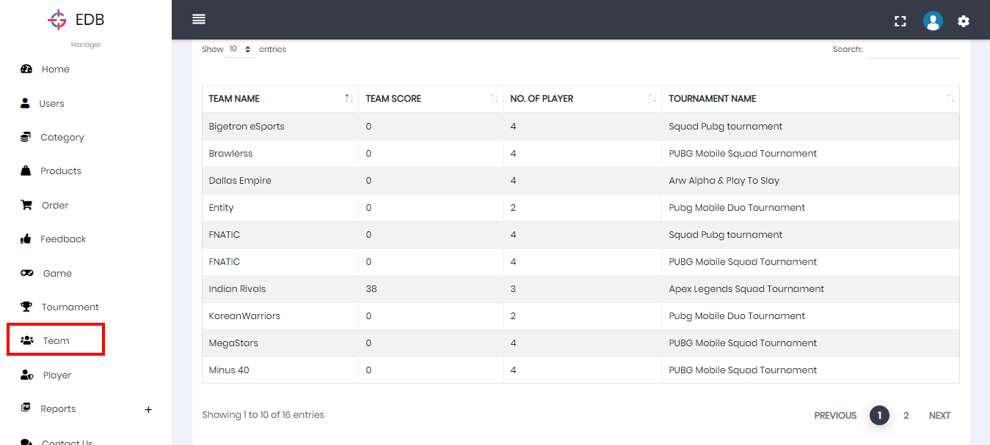
Team Table:
http://127.0.0.1:8000/select-team/

Slide 41
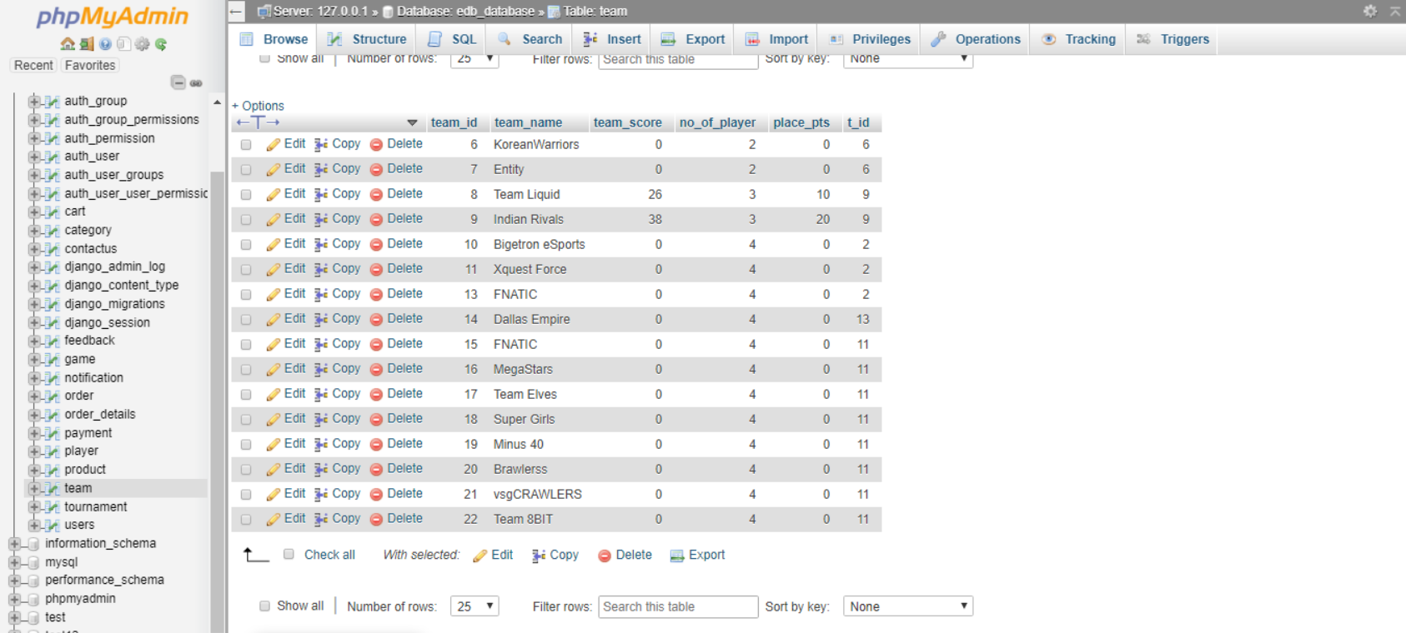
Team Table:
http://localhost:10080/phpmyadmin/sql.php?server=1&db=edb_database&table=team&pos=0

Slide 42
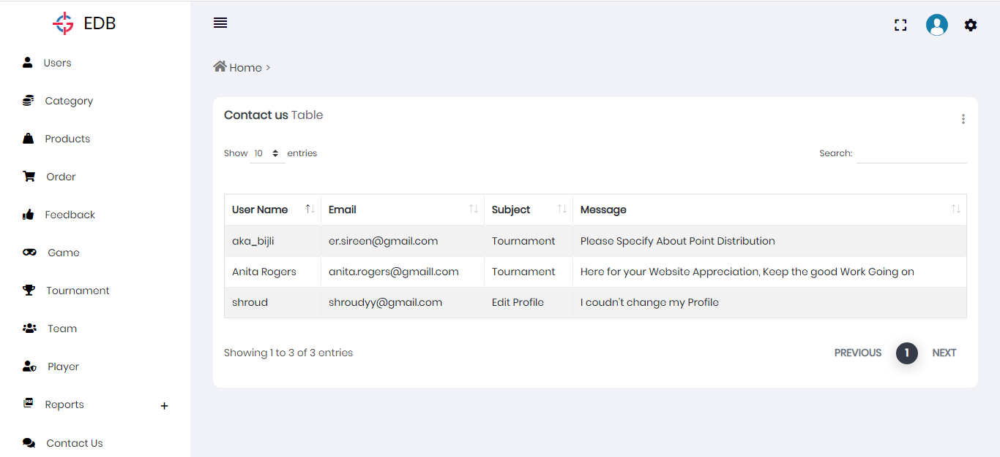
Contact us Table:
http://127.0.0.1:8000/select-contactus/

Slide 43
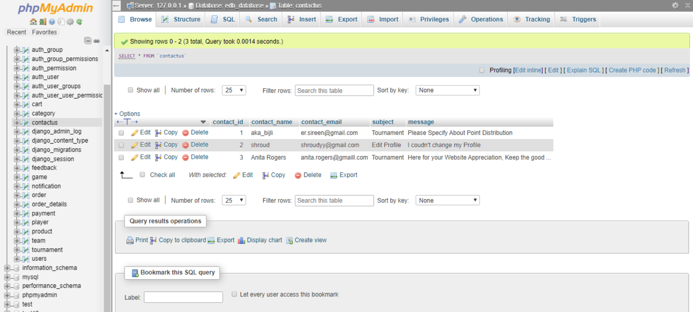
Contact us Table:
http://localhost:10080/phpmyadmin/sql.php?server=1&db=edb_database&table=contactus&pos=0

Slide 44
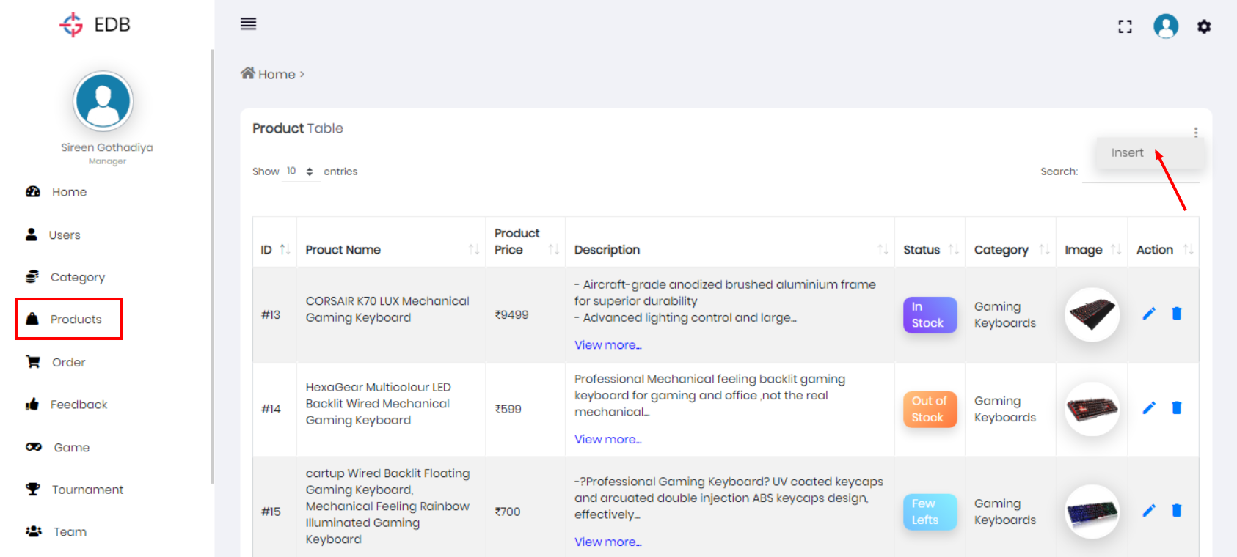
Product Table:
http://127.0.0.1:8000/select-product/

Slide 45
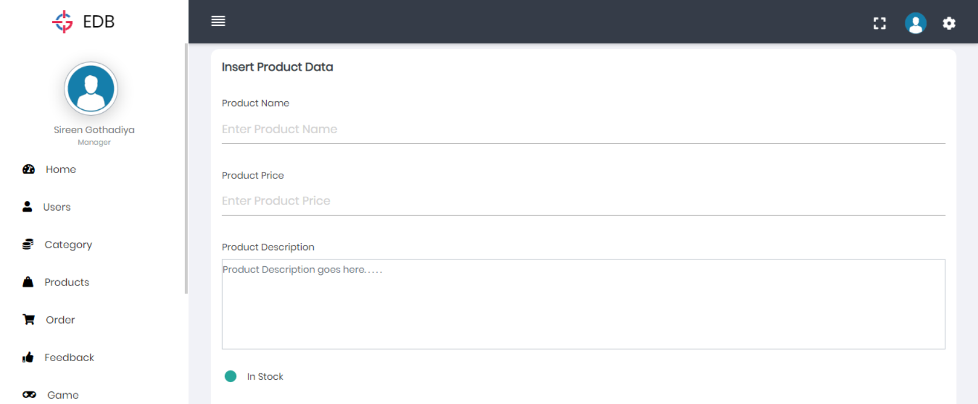
Insert Data in Table:
http://127.0.0.1:8000/product-insert/

Slide 46
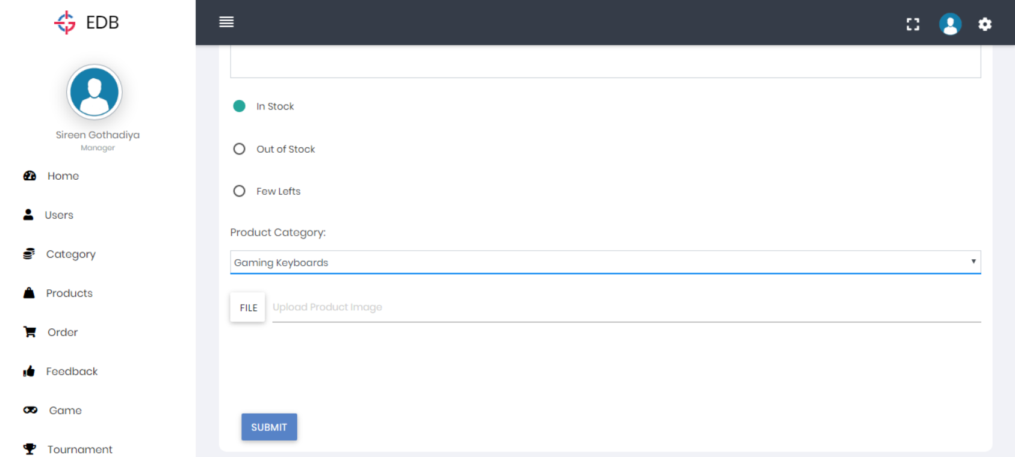
Insert Data in Table:
http://127.0.0.1:8000/product-insert/

Slide 47
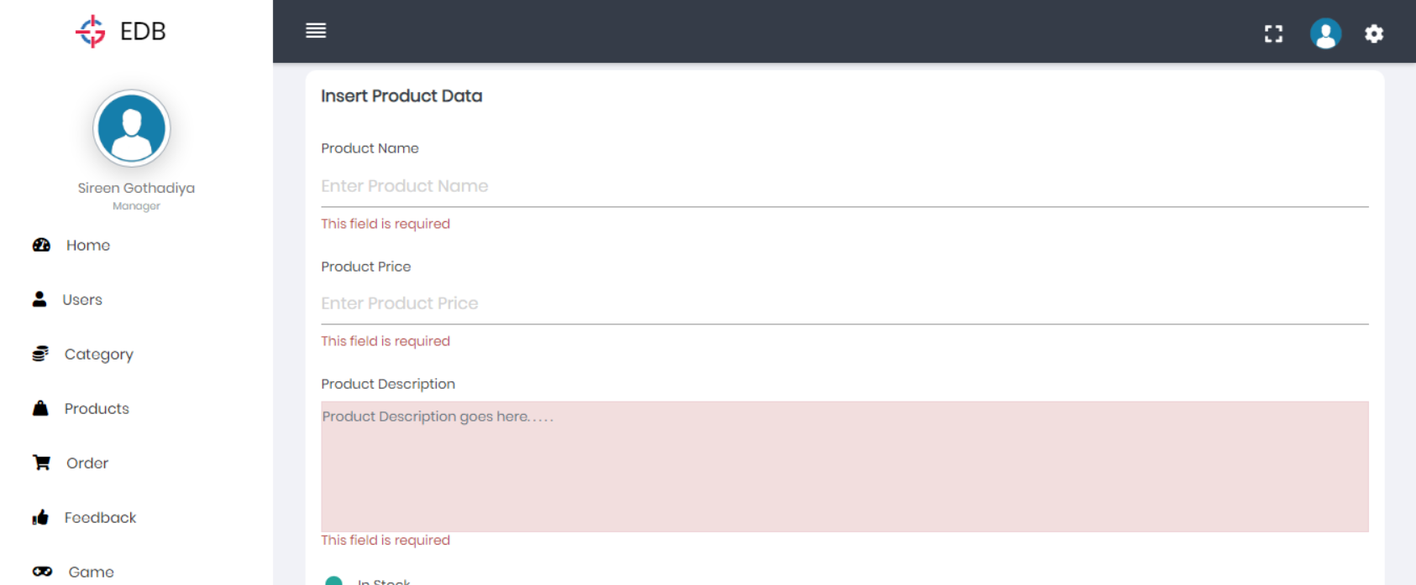
Insert Data in Table:
http://127.0.0.1:8000/product-insert/

Slide 48
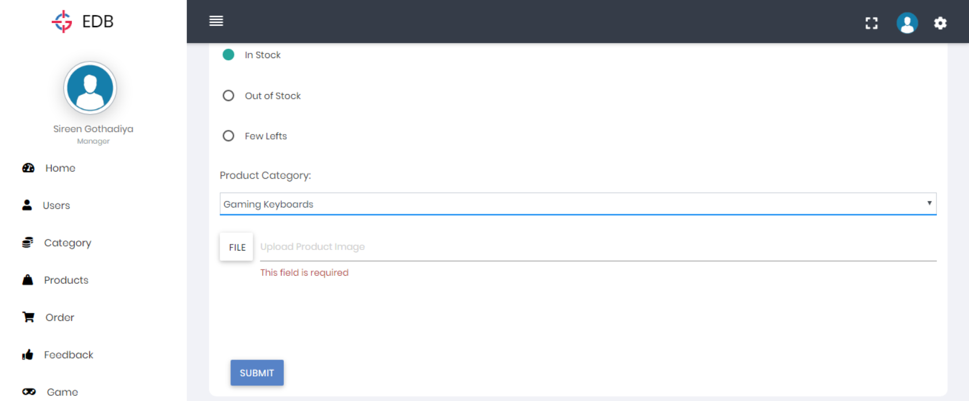
Insert Data in Table:
http://127.0.0.1:8000/product-insert/

Slide 49
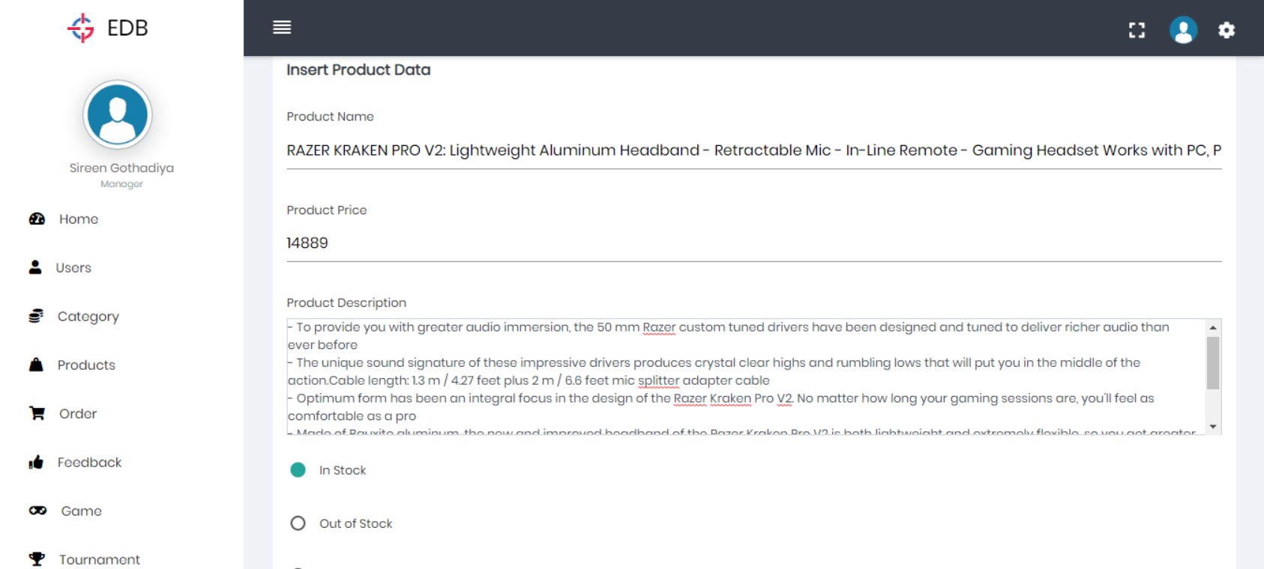
Insert Product:
http://127.0.0.1:8000/product-insert/

Slide 50
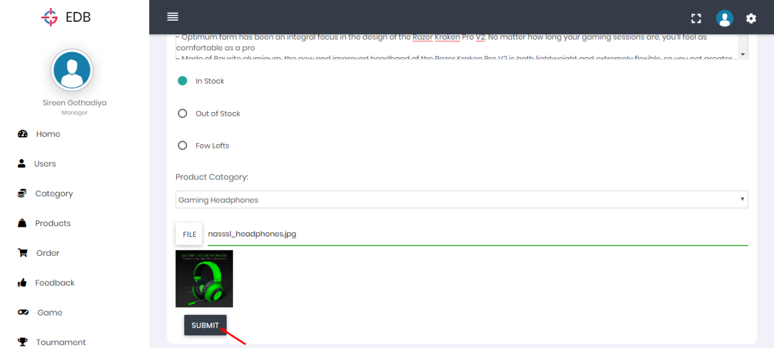
Insert Product:
http://127.0.0.1:8000/product-insert/

Slide 51
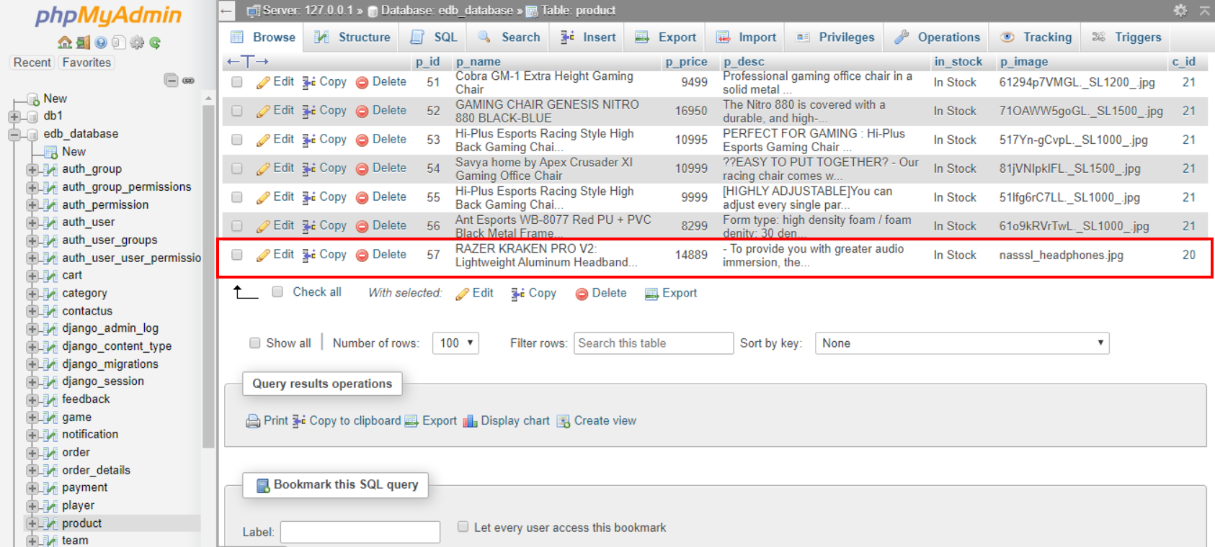
Insert Product:
http://localhost:10080/phpmyadmin/sql.php?db=edb_database&goto=db_structure.php&table=product&pos=0

Slide 52
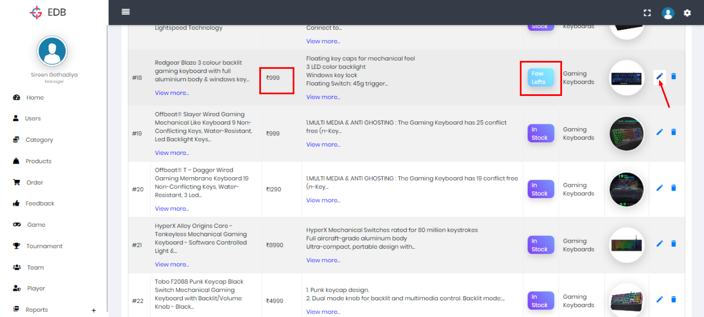
Edit Product:
http://127.0.0.1:8000/select-product/

Slide 53
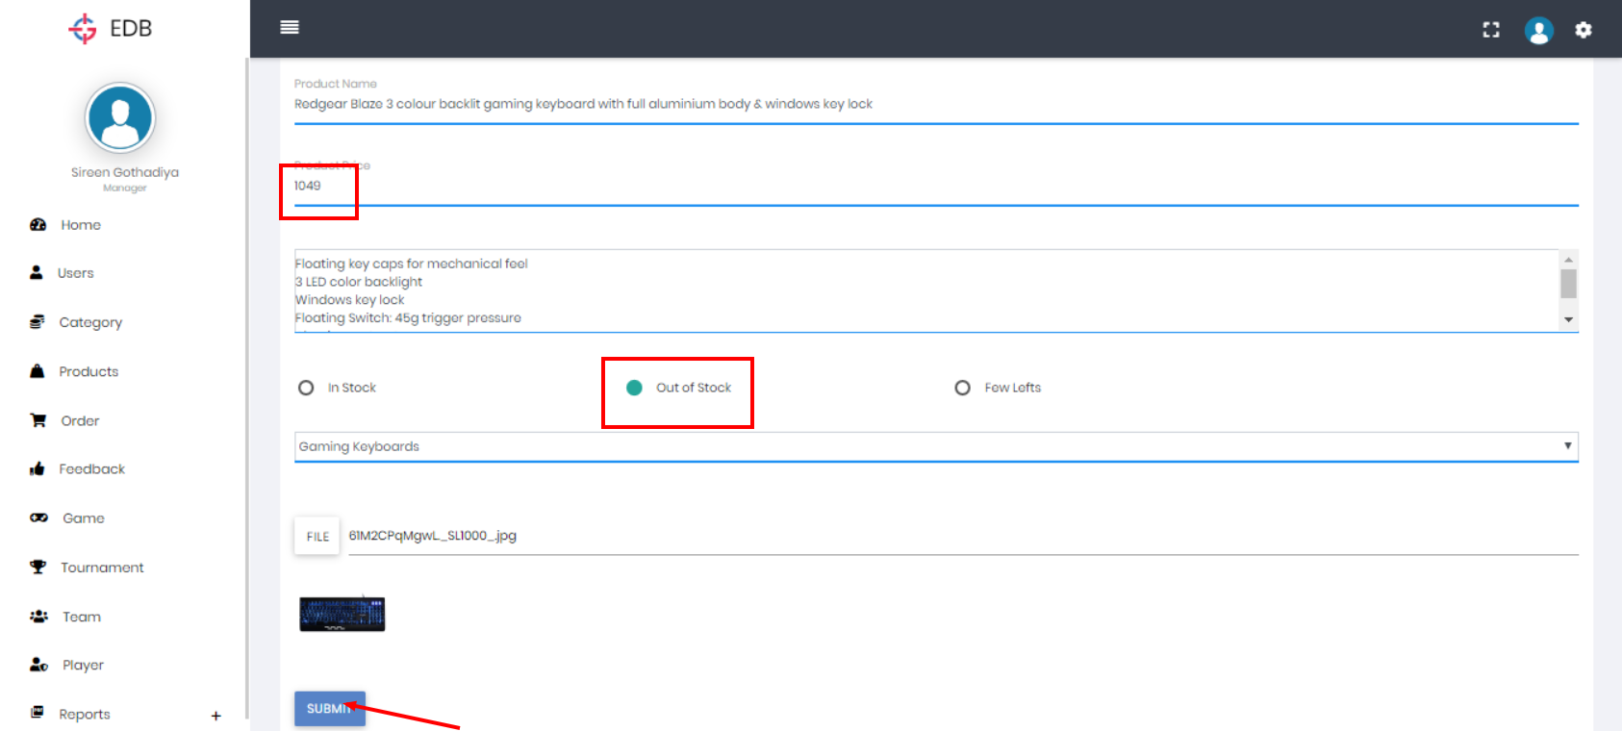
Edit Data:
http://127.0.0.1:8000/productupdate/18

Slide 54
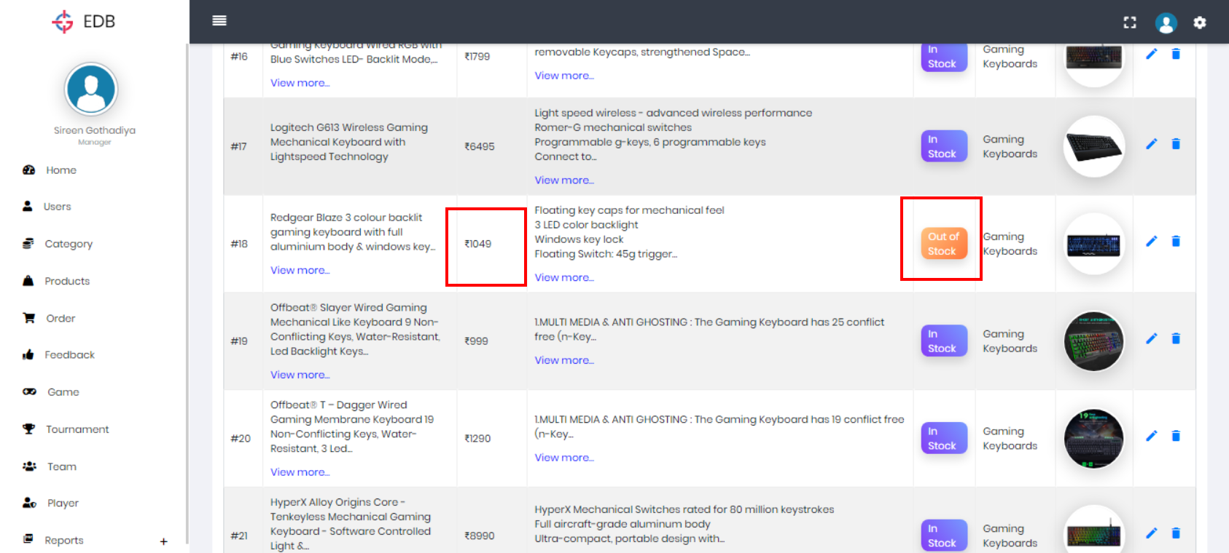
Edit Data:
http://127.0.0.1:8000/select-product/

Slide 55
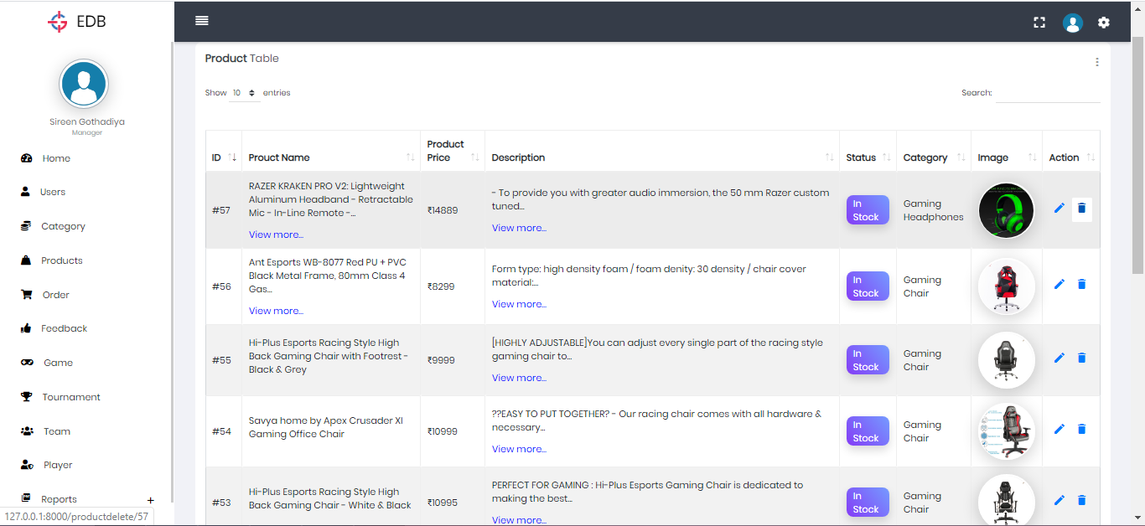
Delete Data:
http://127.0.0.1:8000/select-product/

Slide 56
Delete Data:
http://localhost:10080/phpmyadmin/sql.php?db=edb_database&goto=db_structure.php&table=product&pos=0

Slide 57
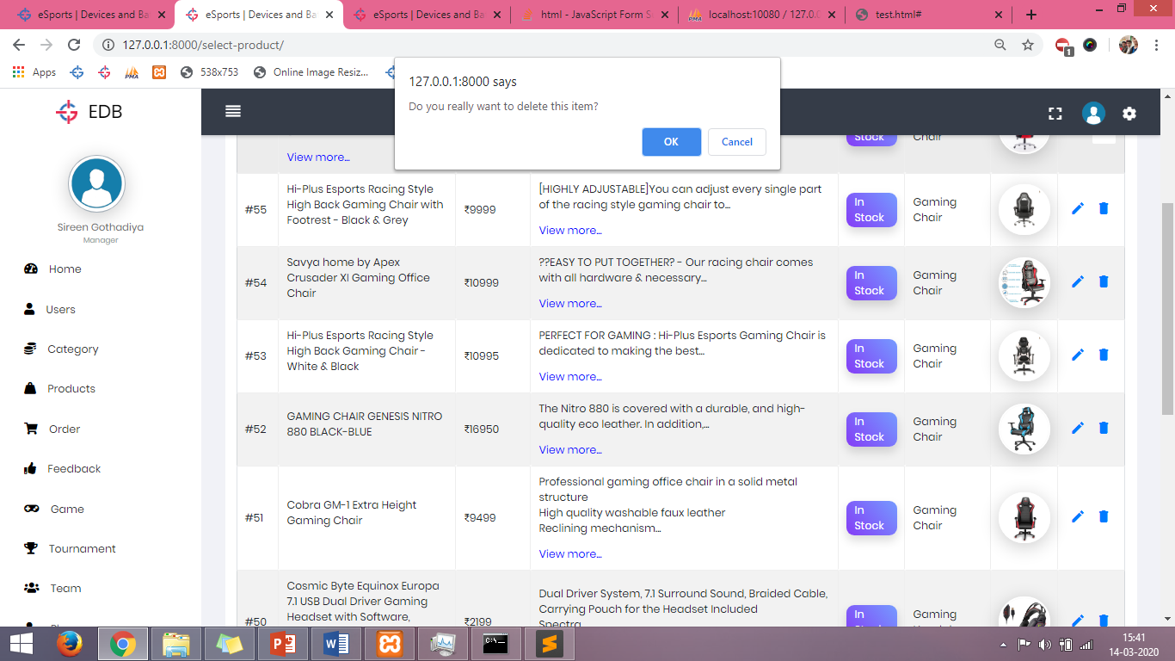
Delete Data:
Generated URL After pressing OK : http://127.0.0.1:8000/productdelete/57

Slide 58
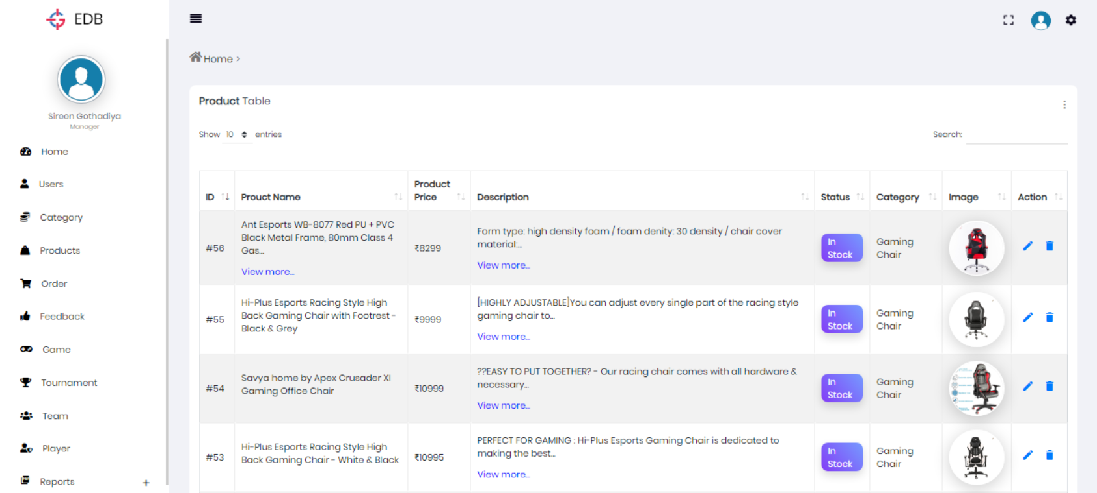
Delete Data:
http://127.0.0.1:8000/select-product/

Slide 59

Delete Data:
http://localhost:10080/phpmyadmin/sql.php?server=1&db=edb_database&table=product&pos=0

Slide 60

Category Table:
http://127.0.0.1:8000/select-category/

Slide 61

Insert Category:
http://127.0.0.1:8000/category-insert/

Slide 62

Game Table:
http://127.0.0.1:8000/select-game/

Slide 63

Insert Game:
http://127.0.0.1:8000/game-insert/

Slide 64

Accept / Reject Order:
http://127.0.0.1:8000/select-order/

Slide 65

Accept / Reject Order:
Registered Gmail Account

Slide 66

Accept / Reject Order:
http://127.0.0.1:8000/select-order/

Slide 67

Add Tournament:
http://127.0.0.1:8000/tournament-insert/

Slide 68

Add Tournament:
http://127.0.0.1:8000/tournament-insert/

Slide 69

Add Tournament:
http://127.0.0.1:8000/select-tournament/

Slide 70

Add Tournament:
http://localhost:10080/phpmyadmin/sql.php?server=1&db=edb_database&table=tournament&pos=0

Slide 71

Send Notification for Tournament Players:
http://127.0.0.1:8000/select-tournament/

Slide 72

Send Notification for Tournament Players:
http://127.0.0.1:8000/send-notification/11

Slide 73

Send Notification for Tournament Players:
http://localhost:10080/phpmyadmin/sql.php?db=edb_database&goto=db_structure.php&table=notification&pos=0

Slide 74

Upload Score for Tournament:
http://127.0.0.1:8000/select-tournament/

Slide 75

Upload Score for Tournament:
Example of Score Summary after Every Match

Slide 76

Upload Score for Tournament:
http://127.0.0.1:8000/upload-score/11

Slide 77

Upload Score for Tournament:
http://127.0.0.1:8000/upload-score/11

Slide 78

Generate Report:
http://127.0.0.1:8000/oreport/

Slide 79

Generate Report:
http://127.0.0.1:8000/filter/1

Slide 80

Generate Report:
Output of generated PDF

Slide 81

Generate Report:
http://127.0.0.1:8000/filter1

Slide 82

Generate Report:
http://127.0.0.1:8000/filter1

Slide 83

Generate Report:
http://127.0.0.1:8000/date_filter/

Slide 84

Generate Report:
http://127.0.0.1:8000/filter1/1

Slide 85

Generate Report:
Output of Date Filtered Report

Slide 86

Generate Report:
Output of Total Money Spend by Users Report.

Slide 87

Generate Report:
Output of All Organized Tournaments Report.

Slide 88

Generate Report:
Output of Number of Registration Done by Users Report.

Slide 89
CLIENT
Layout

Slide 90

Home Page:
http://127.0.0.1:8000/client_page/home

Slide 91

Home Page:
http://127.0.0.1:8000/client_page/home

Slide 92

Home Page:
http://127.0.0.1:8000/client_page/home

Slide 93

Home Page:
http://127.0.0.1:8000/client_page/home

Slide 94

Home Page:
http://127.0.0.1:8000/client_page/home

Slide 95

Authentication Process:
http://127.0.0.1:8000/client_page/home

Slide 96

Authentication Process:
http://127.0.0.1:8000/client_page/client_login

Slide 97

Authentication Process:
http://127.0.0.1:8000/client_page/client_registration

Slide 98

Authentication Process:
http://127.0.0.1:8000/client_page/client_registration

Slide 99

Authentication Process:
http://localhost:10080/phpmyadmin/sql.php?db=edb_database&goto=db_structure.php&table=users&pos=0

Slide 100

Authentication Process:
http://127.0.0.1:8000/client_page/client_login

Slide 101

Authentication Process:
http://127.0.0.1:8000/client_page/client_login

Slide 102

Authentication Process:
http://127.0.0.1:8000/client_page/client_login

Slide 103

Authentication Process:
http://127.0.0.1:8000/client_page/home

Slide 104

Shop Category Page:
http://127.0.0.1:8000/client_page/category

Slide 105

Products Category Wise:
http://127.0.0.1:8000/client_page/shop/cat/17

Slide 106

Single Product:
http://127.0.0.1:8000/client_page/product-detail/22

Slide 107

Single Product:
http://127.0.0.1:8000/client_page/product-detail/22

Slide 108

Single Product:
http://127.0.0.1:8000/client_page/product-detail/22

Slide 109
Single Product:
http://127.0.0.1:8000/client_page/product-detail/22

Slide 110

Cart:
http://127.0.0.1:8000/client_page/cart

Slide 111

My Orders:
http://127.0.0.1:8000/client_page/order

Slide 112

My Orders:
http://127.0.0.1:8000/client_page/order_detail/26

Slide 113

My Orders:
http://127.0.0.1:8000/client_page/edit-order/26

Slide 114

My Orders:
http://127.0.0.1:8000/client_page/edit-order/26

Slide 115

My Orders:
http://127.0.0.1:8000/client_page/order

Slide 116

Check Notifications:
http://127.0.0.1:8000/client_page/notifications

Slide 117

Check Notifications:
Registered Gmail Account

Slide 118

View Payment Services:
http://127.0.0.1:8000/client_page/order

Slide 119

Payment Process:

Slide 120

Payment Process:

Slide 121

Payment Process:

Slide 122

Payment Process:

Slide 123

Payment Process:
http://127.0.0.1:8000/client_page/order

Slide 124

Tournament Registration:
http://127.0.0.1:8000/client_page/games

Slide 125

Tournament Registration:
http://127.0.0.1:8000/client_page/view-tourney/2

Slide 126

Tournament Registration:
http://127.0.0.1:8000/client_page/view-t-detail/11

Slide 127

Tournament Registration:
http://127.0.0.1:8000/client_page/view-t-detail/11

Slide 128

Registration Form:
http://127.0.0.1:8000/client_page/register-tournament/11

Slide 129

Registration Form:
http://127.0.0.1:8000/client_page/my_tournaments

Slide 130

Check Notification:
http://127.0.0.1:8000/client_page/notifications

Slide 131

Check Score/Participants:
http://127.0.0.1:8000/client_page/view-t-detail/11

Slide 132
Thank You

